Slide 1


K.RAMAKRISHNAN COLLEGE OF TECHNOLOGY
(AUTONOMOUS), TRICHY.
DISASTER MANAGEMENT SYSTEM
PRESENTED BY:
DEEPIKA S
2303811710422022
SUPERVISOR
Mr. M. Saravanan, M.E.,
AP/CSE.

Slide 2
PRESENTATION OVERVIEW
Objective
Project Introduction
Problem Statement
Methodologies (Programming concepts relevant to problem statement)
Architecture of the proposed system
List of Modules
7. Merits
8. Result and Discussion
9. Queries

Slide 3
OBJECTIVE
The objective is to create a centralized disaster management platform that allows for efficient reporting, tracking, and managing of disaster-related information, improving coordination and response times during emergencies.
To design and implement a Java-based system that enhances disaster management by enabling real-time disaster reporting, efficient coordination of rescue teams, and effective resource allocation, ultimately improving the speed and effectiveness of emergency response during disasters.

Slide 4
PROJECT INTRODUCTION
This project focuses on creating a Disaster Management System that simplifies the management of disaster-related information.
The system provides functionalities to record disasters, assign rescue teams, and retrieve stored data efficiently.
The application aims to act as a centralized system for managing emergencies by reducing delays and improving decision-making.

Slide 5
PROBLEM STATEMENT
Disaster management processes often suffer from:
Lack of centralized systems for disaster reporting and rescue team management.
Delays in communication and response time during emergencies.
Difficulty in keeping track of resources and personnel involved in disaster response.
This project aims to solve these problems by implementing a system that allows users to:
Report disasters in real-time.
Manage and track rescue teams.
View disaster and rescue data effectively.

Slide 6
METHODOLOGIES
Object-Oriented Programming (OOP):
(Disaster, RescueTeam) and objects are used to model disaster and rescue data.
Event Handling:
Using ActionListener to handle button actions such as adding/viewing data.
Graphical User Interface (GUI):
Developed using Java AWT to create user-friendly forms and buttons.
Collections Framework:
ArrayList is used to store and manage disaster and rescue team data dynamically.
Exception Handling:
Ensures robust handling of user input errors and system anomalies.

Slide 7
ARCHITECTURE OF THE PROPOSED SYSTEM
START
ADD DISASTER
VIEW DETAILS
ADD RESCUE TEAM
VIEW RESCUE TEAM
EXIT
Enter Disaster Name
Enter Disaster Location
Enter Disaster Severity
Enter Rescue Team
Enter Contact Number
STOP

Slide 8
LIST OF MODULES
1.Add Disaster:
Allows the user to input disaster details (type, location, and description).
2.View Disaster:
Displays all stored disasters with details like type, location, and description.
3.Add Rescue Team:
Enables input of rescue team details (name, members, assigned location, and contact info).
4.View Rescue Team:
Displays all rescue teams and their assigned locations.
5.Exit:
Safely closes the application.

Slide 9
MERITS
1.Efficiency:
Provides an organized way to manage disaster-related information.
2.User-Friendly:
Simple GUI ensures easy use by non-technical personnel.
3.Real-Time Updates:
Disaster reports and rescue team details can be updated dynamically.
4.Modularity:
Clear division into modules for easy maintenance and extension.
5.Portability:
As a Java-based application, it is platform-independent.

Slide 10
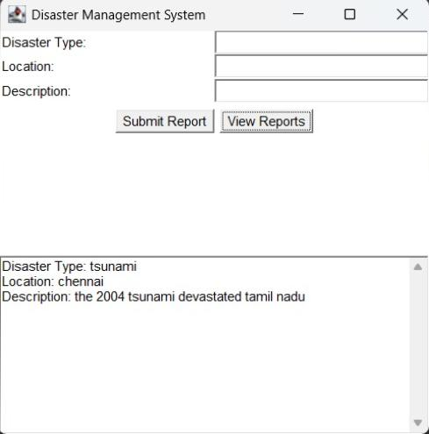
RESULTS AND DISCUSSION

Slide 11
QUERIES ?

